Slide 1
Communicating Windows Azure Service Bus with multiple platforms
Aigars Mačiņš
Microsoft Latvia Technical Evangelist
Valdis Iljučonoks
C# MVP, Lead Technologist at Geta Latvia

Slide 2
Content
Use case scenarios. Arhitecture problems
ServiceBus
Demo with Linux VM/Java (todo)

Slide 3
Service
Bus
denotes non-iterative and autonomously executing programs that communicate with other services through message exchange
is used in analogy to a computer hardware bus

Slide 4
from «ESB» counterpart
Just a «SB»

Slide 5
Use Case

Slide 6

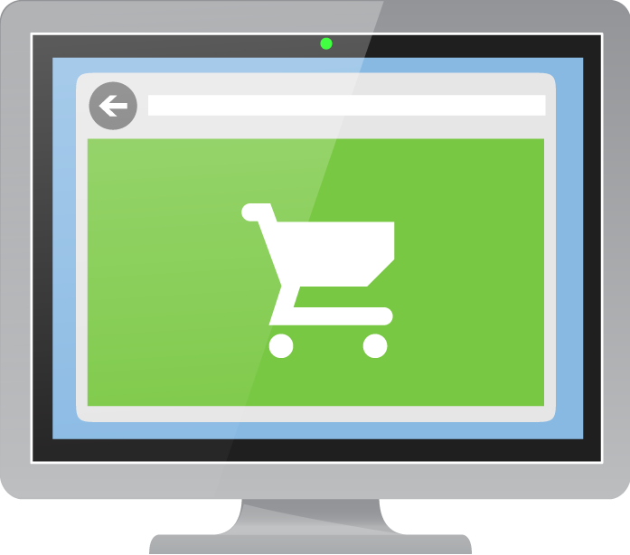

Example: Tightly Coupled Application
Drivers
Tracking
Store Front End
Shipping Service
Notes:
Although integrating systems is a key reason you would use service bus, it is also used within applications to decouple parts of the applications so that you can provide built in resilience and mechanism to scale your applications easily. These slides illustrate both these principles starting with resilience.
In normal systems, components are tightly coupled which means that if any one of them fails, the whole thing fails and creates bad user experiences.

Slide 7

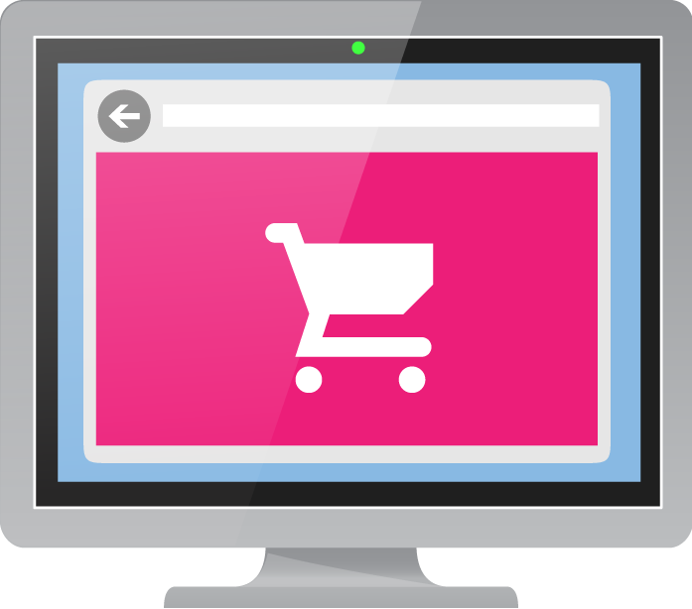

Example: Tightly Coupled Application
Drivers
Tracking
Store Front End
Shipping Service

Slide 8
Example: Loosely Coupled Application
Drivers
Tracking
Store Front End
Order Queue
Shipping Service
Notes:
By loosely coupling back and front ends of an application and shifting the application architecture to process transactions differently, the front end can send shipping requests first to a queue. Once on the queue, the store front end can send an acknowledgement to the user confirming the order. The assumption is that the order will get shipped. If there is some downstream problem, the system will have to communicate back to the user outside of the order transaction (for example – maybe the requested shipping date was not available).
The Shipping service get’s orders from the queue in this architecture, it is not being SENT orders from the store front end. When the shipping service is working correctly – it just continues to get orders from the queue. If for some reason the Store Front end fails and there is a backlog of orders on the queue, the shipping service can still work. Likewise, if the shipping service is down, the store front end can still take orders.

Slide 9

Example: Loosely Coupled Application
Drivers
Tracking
Store Front End
Order Queue
Shipping Service

Slide 10
Benefits
Guaranteed delivery
Loosely coupled
Interoperability
Low cost maintenance

Slide 11
Various Models
Queues
Topics
Relay
Notifcation hubs *

Slide 12
Openness
Not only Windows Azure
Not only .Net Framework
Not only HTTP

Slide 13
Demo

Slide 14
Performance Metrics

Slide 15
Maximum throughput
Up to 2,000 messages per second *
Average latency
100 ms
* - based on benchmark with 1 KB messages

Slide 16
Pricing

Slide 17
€0.0075 for every 10,000 messages *
* - query against empty queue is billable transaction

Slide 18
Q & A

Slide 19
Example: Loosely Coupled Application
Drivers
Tracking
Store Front End
Order Queue
Shipping Service

Slide 20



Example: Loosely Coupled Application
Tracking
Tracking
Store Front End
Order Queue
Shipping Service
Notes:
In this example we show that the shipping service can itself consist of multiple instances of worker processes that are pulling orders from the order queue. Each process will just pull one order, the queue guarantees order as well as ensuring that only 1 message is delivered to one instance of the tracking service. In this way, if you have many orders coming in, it is easy to add more worker instances to process these orders.

Slide 21
Messaging Features
Service Bus Queues:
Scenario: Multiple systems and remote clients need to send business events to head office which processes these messages under varying load.
Solution: Queues decouple senders from receivers, multiple receivers can handle varying load, simple to add new senders without impact.
Message Queue: FIFO Resilient Queue
D
C
B
A
E
Service Bus Topics:
Scenario: Multiple actions have to be taken as a result of incoming messages from external systems but these actions frequently change.
Solution: Topics are special queues that have subscriptions which contain rules to determine which messages a subscription will contain.
Topic: Queue with 1:n rule based subscriptions
Notes:
The Service Bus 1.0 supports the same brokered messaging feature set as the Windows Azure Service Bus. Service Bus queues offer reliable message storage and retrieval with a choice of protocols and APIs.
Service Bus Queues
Service Bus queues provide load leveling by allowing the message receiver to process messages at its own pace. In addition, Service Bus queues provide load balancing by having multiple competing receivers that accept messages from the same queue.
Service Bus Topics
In addition to queue features, Service Bus topics and subscriptions provide rich publish-subscribe capabilities that enable multiple, concurrent subscribers to independently retrieve filtered or unfiltered views of the published message stream.

Slide 22
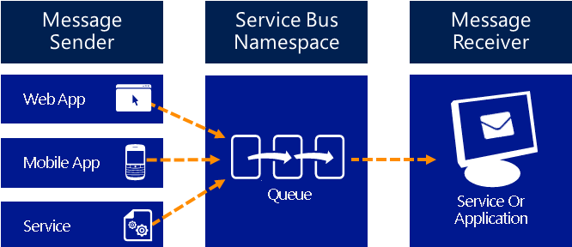
Service Bus Queues
One way asynchronous messaging.
Notes:
Service Bus Queues support a brokered messaging communication model. When using queues, components of a distributed application do not communicate directly with each other, they instead exchange messages via a queue, which acts as an intermediary. A message producer (sender) hands off a message to the queue and then continues its processing. Asynchronously, a message consumer (receiver) pulls the message from the queue and processes it. The producer does not have to wait for a reply from the consumer in order to continue to process and send further messages.
Queues offer First In, First Out (FIFO) message delivery to one or more competing consumers. That is, messages are typically received and processed by the receivers in the order in which they were added to the queue, and each message is received and processed by only one message consumer. Using queues can enable you to scale out your applications better, and enable more resiliency to your architecture.
Between web and worker roles in a multi-tier application.
Between existing datacenter apps and Windows Azure Pack hosted apps for a hybrid solution.
Between components of a distributed application running on-premises in different organizations or departments of an organization.

Slide 23
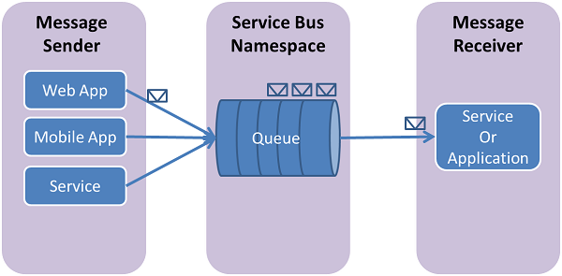
Service Bus Queues
Service Bus Queues support a brokered messaging communication model.
Scenarios include:
  Communication between web and worker roles in a multi-tier application
  Communication between on-premises apps and Windows Azure hosted apps in a hybrid solution
  Communication between components of a distributed application running on-premises in different organizations or departments of an organization
Notes:
Service Bus Queues support a brokered messaging communication model. When using queues, components of a distributed application do not communicate directly with each other, they instead exchange messages via a queue, which acts as an intermediary. A message producer (sender) hands off a message to the queue and then continues its processing. Asynchronously, a message consumer (receiver) pulls the message from the queue and processes it. The producer does not have to wait for a reply from the consumer in order to continue to process and send further messages. Queues offer First In, First Out (FIFO) message delivery to one or more competing consumers. That is, messages are typically received and processed by the receivers in the order in which they were added to the queue, and each message is received and processed by only one message consumer. Using queues can enable you to scale out your applications better, and enable more resiliency to your architecture.

Slide 24

Example: ServiceBus Queues
Publisher
Consumer
Publisher
myqueue
Notes:
This is a simple animation that shows the basic mechanics of a queue. We have publishers and consumers. Using a simple API, a publisher creates a message that contains message properties and data. These messages are created by the publisher and there does need to be some agreement between publishers and consumers on what the message properties and content are so that each understands how to handle the data in the messages.
The Queue itself does not PULL and it DOES NOT push data – it is simply a store for the messages and ensures the right ordered delivery of the messages for consumers who ASK for a message.
The typical pattern for consumers is to run in a loop, polling for messages from the queue.

Slide 25

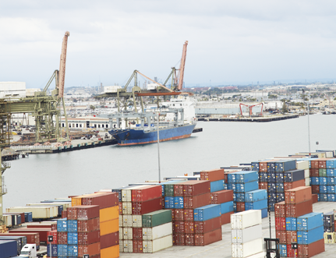
Service Bus
Reliable messaging services to enable asynchronous messaging for distributed applications
Reliable Message Delivery
Connect to on-premises applications
Queues & Topics
Notes:
Reliable Message Delivery
The Service Bus service is a messaging infrastructure that sits between applications allowing them to exchange messages in a loosely coupled way for improved scale and resiliency.
Connect on-premises applications Service Bus Relay solves the challenges of communicating between traditional applications and the outside world by allowing traditional web services to project public endpoints. Systems can then access these web services, which continue to run on-premises from anywhere on the planet.
Queues and Topics
Service Bus Queues offer simple first in, first out guaranteed message delivery and supports a range of standard protocols (REST, AMQP, WS*) and API’s to put/pull messages on/off a queue. Service Bus Topics deliver messages to multiple subscriptions and easily fan out message delivery at scale to downstream systems.

Slide 26
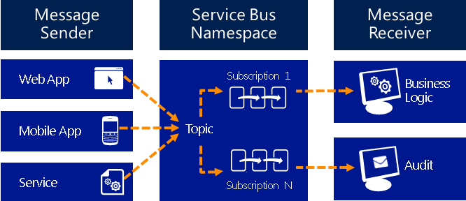
Service Bus topics and subscriptions
Publish-subscribe one-to-many messaging.
Notes:
Service Bus topics and subscriptions support a publish/subscribe messaging communication model. When using topics and subscriptions, components of a distributed application do not communicate directly with each other, they instead exchange messages via a topic, which acts as an intermediary.
In contrast to Service Bus queues, where each message is processed by a single consumer, topics and subscriptions provide a one-to-many form of communication, using a publish/subscribe pattern. It is possible to register multiple subscriptions to a topic. When a message is sent to a topic, it is then made available to each subscription to handle/process independently.
A topic subscription resembles a virtual queue that receives copies of the messages that were sent to the topic. You can optionally register filter rules for a topic on a per-subscription basis, which allows you to filter/restrict which messages to a topic are received by which topic subscriptions.
Service Bus topics and subscriptions support a publish/subscribe messaging communication model.
Components of a distributed
application do not communicate
directly with each other, they instead exchange messages via a topic, which
acts as an intermediary.
Subscriptions provide a one-to-many
form of communication, using a publish/subscribe pattern.
subscriptions enable you to scale to process a very large number of messages across a very large number of users and applications.

Slide 27
Service Bus … relay

Slide 28
Example : Service Bus Topics
Consumer 1
B
Publisher
myFirstSubscription
A
A
Subscription
Rule
Color=BLUE
E
B
Consumer 2
A
B
A
C
E
Publisher
mySecondSubscription
C
E
D
C
myTopic
E
Consumer 3
A
B
Notes:
Topics are in essence, just more complex queues. We have the same publisher and consumer model. The difference is that with topics, you create one or more subscriptions which themselves can have rules that will only select certain messages sent to the topic. Publishers send to the Topic, but Consumers receive from one or more subscriptions. The Rules are applied (using the Service Bus API – there is no tooling/UI for this (Yet)) to subscriptions which affect which messages get to that subscription. The animation shows that you can actually set rules up after messages are already waiting at the subscription causing the subscription to have different messages that the subscription rule would indicate.

Slide 29
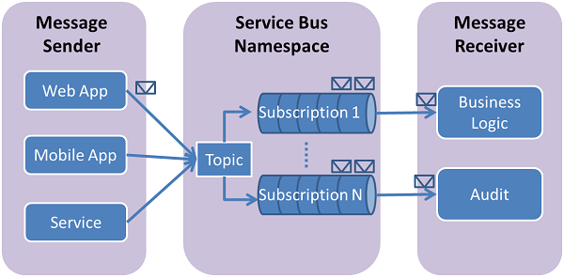
Service Bus Topics/Subscriptions
  Service Bus topics and subscriptions support a publish/subscribe messaging communication model.
  Components of a distributed application do not communicate directly with each other, they instead exchange messages via a topic, which acts as an intermediary.
  Subscriptions provide a one-to-many form of communication, using a publish/subscribe pattern
Notes:
Service Bus topics and subscriptions support a publish/subscribe messaging communication model. When using topics and subscriptions, components of a distributed application do not communicate directly with each other, they instead exchange messages via a topic, which acts as an intermediary.
In contrast to Service Bus queues, where each message is processed by a single consumer, topics and subscriptions provide a one-to-many form of communication, using a publish/subscribe pattern. It is possible to register multiple subscriptions to a topic. When a message is sent to a topic, it is then made available to each subscription to handle/process independently.
A topic subscription resembles a virtual queue that receives copies of the messages that were sent to the topic. You can optionally register filter rules for a topic on a per-subscription basis, which allows you to filter/restrict which messages to a topic are received by which topic subscriptions.
Service Bus topics and subscriptions enable you to scale to process a very large number of messages across a very large number of users and applications.

Slide 30
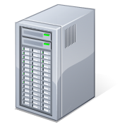
Example: ServiceBus Queues
Publisher
Consumer
Publisher
myqueue
Notes:
This is a simple animation that shows the basic mechanics of a queue. We have publishers and consumers. Using a simple API, a publisher creates a message that contains message properties and data. These messages are created by the publisher and there does need to be some agreement between publishers and consumers on what the message properties and content are so that each understands how to handle the data in the messages.
The Queue itself does not PULL and it DOES NOT push data – it is simply a store for the messages and ensures the right ordered delivery of the messages for consumers who ASK for a message.
The typical pattern for consumers is to run in a loop, polling for messages from the queue.

Slide 31

Service Bus Topics
Consumer 1
B
Publisher
myFirstSubscription
A
Subscription
Rule
Color=GREEN
A
E
B
Consumer 2
A
A
E
B
C
Publisher
mySecondSubscription
C
E
myTopic
D
C
E
Consumer 3
A
B
Notes:
Topics are in essence, just more complex queues. We have the same publisher and consumer model. The difference is that with topics, you create one or more subscriptions which themselves can have rules that will only select certain messages sent to the topic. Publishers send to the Topic, but Consumers receive from one or more subscriptions. The Rules are applied (using the Service Bus API – there is no tooling/UI for this (Yet)) to subscriptions which affect which messages get to that subscription. The animation shows that you can actually set rules up after messages are already waiting at the subscription causing the subscription to have different messages that the subscription rule would indicate.

Slide 32
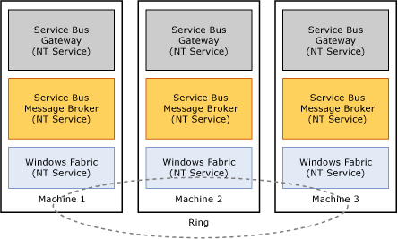
Process and Execution Model
Each Service Bus has three key processes: the Service Bus Gateway, Service Bus Message Broker and Windows Fabric
Service Bus server farm is “highly available”, via inter-process communication that spans local and remote computers.
  The Service Bus gateway process is a stateless service and can communicate with the message broker on local or remote machines within the farm.
  The Service Bus message broker process on every machine registers with the Windows Fabric service (on the same machine). This registration indicates availability to host Windows Fabric services.
  The Windows Fabric services on every machine communicate with each other to establish a “Highly Available Ring.”
Notes:
Service Bus is built on the Microsoft .NET Framework 4.0 PU3, Windows Server 2008 R2, SQL Server 2008 R2 and SQL Database, and Windows PowerShell 3.0. All these platforms must be running on a 64-bit operating system. The storage layer for the system (SQL) can be on dedicated remote server or on one of the compute nodes or in Windows Azure SQL Database. The compute nodes used this stack can be hosted either on-premises or on Windows Azure IAAS.

Slide 33
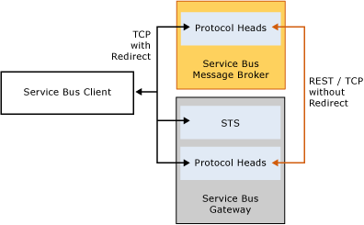
Service Bus Gateway
All incoming requests from clients are first received and processed by the Service Bus Gateway
Protocol Heads process the requests and perform the necessary authentication, authorization, and address resolution
Request is then forwarded to the appropriate message broker
Clients can use Net.TCP or REST over HTTP
Notes:
All incoming requests from clients are first received and processed by the Service Bus Gateway. The protocol heads process the requests and perform the necessary authentication, authorization, and address resolution. The request is then forwarded to the appropriate message broker. In some cases, the client then communicates with the message broker directly for subsequent requests.
Clients can use Net.TCP or REST over HTTP as the protocol for communication with the Service Bus 1.0 server.
Net.TCP Interaction
When a Net.TCP client requests is received at the gateway, it identifies the host (message container) for the messaging entity, such as a queue, topic, or subscription. The service then forwards the requests to the appropriate Service Bus message broker (local or remote) in which the message container is running.
The messaging redirect mode is supported for Net.TCP requests only. In this mode, after authentication and authorization the client can ask the gateway to respond with the address of the Service Bus message broker. The client can then connect directly to the Service Bus message broker for subsequent requests. This feature reduces the overhead of routing all requests through the gateway for every message sent over the wire.
REST interaction
When a client requests REST over HTTP as the protocol, the gateway NT service identifies the host (message container) for the messaging entity, such as a queue, topic, or subscription. The service then forwards the requests to the appropriate Service Bus message broker (local or remote) in which the message container is running. The REST interaction pattern does not support the messaging redirect feature.

Slide 34
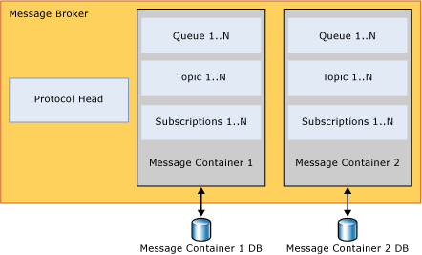
Service Bus Message Broker
The message broker is a service that hosts the protocol head and one or more message containers
  Logical collection of runtime (compute) logic that is backed by a persistent store (SQL Database).
Registers with WF and acts as a host for the message container service
  WF determines the number of registered instances and places them on the various machines in the farm based on a simple load balancing algorithm
Notes:
The message broker is an NT service that hosts the protocol head and one or more message containers. The service registers itself with Windows Fabric and acts as a host for the message container service.
Message Container
You can view the message container as a logical collection of runtime (compute) logic that is backed by a persistent store (SQL Database). In the case of failover or for load balancing, the message container is a modular service that moves. Each message container is backed by a store (SQL database) and hosts a set of queues, topics, and subscriptions as determined by a simple round-robin capacity management algorithm. Entities such as queues, topics, and subscriptions placed in a container cannot be moved, and remain with the container and its associated database. All state related to the message container is persisted in the database.
Windows Fabric
This process contains the core logic necessary for high availability, farm and cluster formation, and load balancing across machines in the farm. The messaging broker service on each machine registers with the Windows Fabric process on respective machines. Windows Fabric determines the number of registered instances of the message container service and places them on the various machines in the farm based on a simple load balancing algorithm.

Slide 35
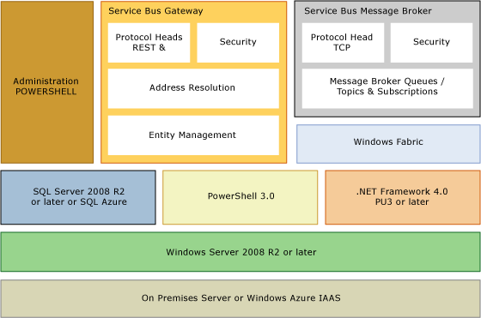
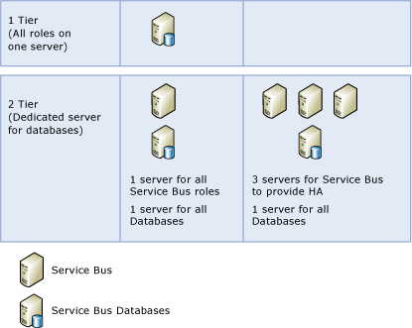
Service Bus Platform Stack & Deployment
Built on .NET 4.0 PU3 or later
Can use Windows Server 2008 R2 or Windows Server 2012
Support for SQL Server 2008 R2 or later, or SQL Azure
Can be deployed on-premises or via Windows Azure IAAS (or Service Provider equivalent)
The Service Bus 1.0 only supports a farm with 1 computer or a farm with 3 computers.
SQL Server can be installed locally or remotely
Databases can reside on multiple machines as well. All of them need not be created on a single database server.
Notes:
Service Bus 1.0 is built on the Microsoft .NET Framework 4.0 PU3, Windows Server 2008 R2, SQL Server 2008 R2 and SQL Database, and Windows PowerShell 3.0. All these platforms must be running on a 64-bit operating system. The storage layer for the system (SQL) can be on dedicated remote server or on one of the compute nodes or in Windows Azure SQL Database. The compute nodes used this stack can be hosted either on-premises or on Windows Azure IAAS.
The Service Bus 1.0 provides a messaging platform for enterprise applications with a multi-host farm topology that provides both scale and high availability. The platform is based on Windows Server and Microsoft SQL Server. Developers that want a lightweight development environment can install the Service Bus 1.0 on Windows client operating systems (64-bits) and Microsoft SQL Express.
You can deploy the Service Bus 1.0 in a hosted environment such as Windows Azure Virtual Machines using a hosted Microsoft SQL Server database, or Windows Azure SQL Database (IaaS).

Slide 36
Comparing Service Bus 1.0 with Windows Azure Service Bus
Service Bus 1.0 requires on-premises installation and support
As Windows Azure Access Control Service (ACS) is not available for Service Bus 1.0, it includes a simple Service Bus Security Token Service (SBSTS) integrated with the Windows security model
  The SBSTS can issue Simple Web Tokens (SWTs) based on Windows identities
  Quotas and other runtime settings are fixed in the Windows Azure Service Bus, with the Service Bus 1.0 an administrator can change those settings
  With the Service Bus 1.0, you can use the fully qualified domain name (FQDN) of the hosts, or a mapped DNS entry representing your service.
  Fully
Notes:
Although symmetry exists between Service Bus 1.0 and Windows Azure Service Bus in APIs and messaging features, there are differences between the two Service Bus products.
With respect to manageability, in a hosted Platform As A Service (Windows Azure) environment, the PaaS vendor (Microsoft) provides the management. With the Service Bus 1.0, the local administrator deploys, secures, scales, and monitors the Service Bus 1.0 farm.
In both Windows Azure and Windows Server, the Service Bus requires access tokens for authorizing access to its messaging entities. Because the Windows Azure Access Control Service (ACS) is not available on Windows Server, the Service Bus 1.0 includes a simple Service Bus Security Token Service (SBSTS) integrated with the Windows security model. The SBSTS can issue Simple Web Tokens (SWTs) based on Windows identities (stored in the local Windows identity store or in Active Directory).
While quotas and other runtime settings are fixed in the Windows Azure Service Bus, with the Service Bus 1.0 an administrator can change those settings and customize the Service Bus 1.0 farm.
The addressing schema is fixed in the Windows Azure Service Bus. In other words, all the endpoints have the Service Bus postfix added to the URL. With the Service Bus 1.0, you can use the fully qualified domain name (FQDN) of the hosts, or a mapped DNS entry representing your service.

Slide 37
[]
Create new SB namespace
Create new Linux/Ubuntu VM from gallery
--
Use previusly prepeared images to show demo
--
Show Java Web that listens to messages (Eclipse code)
Say that it is deployed on VM.
--
Run Modern-UI app on tablet that sends «purchase» to SB
--
Show public java application url where message should appear.
--
Show another url where messages could be pushed from REST intreface.
-
Offer guys to ask questions using this URL. Show QR
Notes:
_A_A_A_

Slide 38
Q&A

